Slide 1
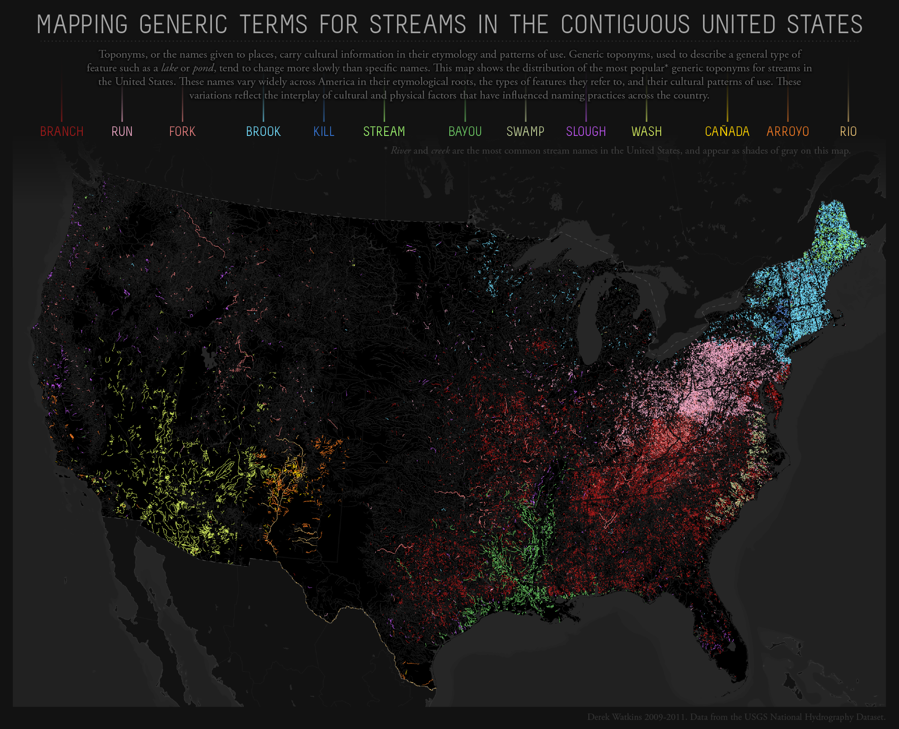

Slide 2
Intermediate GIS
GEOG 558

Slide 3
Plan for this week
Tuesday:
Fundamentals of Mapping
Types of Data
Sources of Data
Thursday:
Guest Lecture Kristen Koenig - DASC

Slide 4
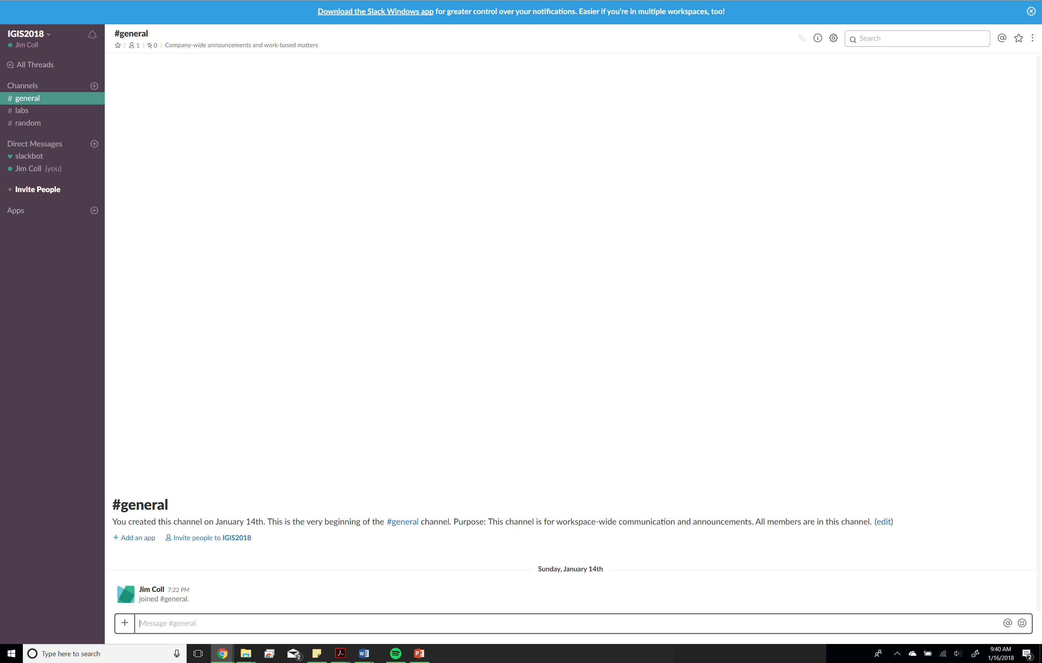
ArcGIS Signup & Slack
https://docs.google.com/spreadsheets/d/1RTPhUiCE5RQFGIFa5iEX6kz4MWgEweVldInDvnJQNVg/edit?usp=sharing

Slide 5
Fundamentals of Mapping
What can be mapped?
How to map?
Field
Remote Sensing
Crowd sourcing
Volunteered Geographic Information
VGI
Micro mapping
How technology has changed mapping

Slide 6
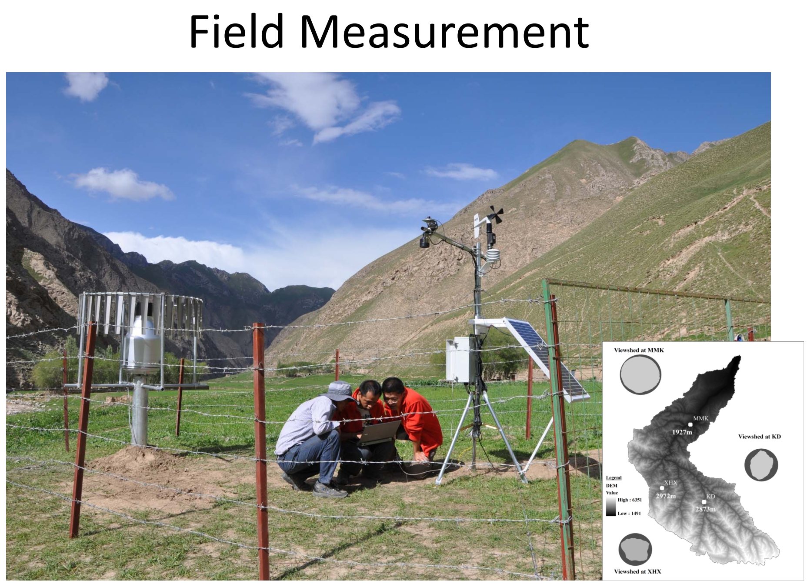
Field Measurments

Slide 7
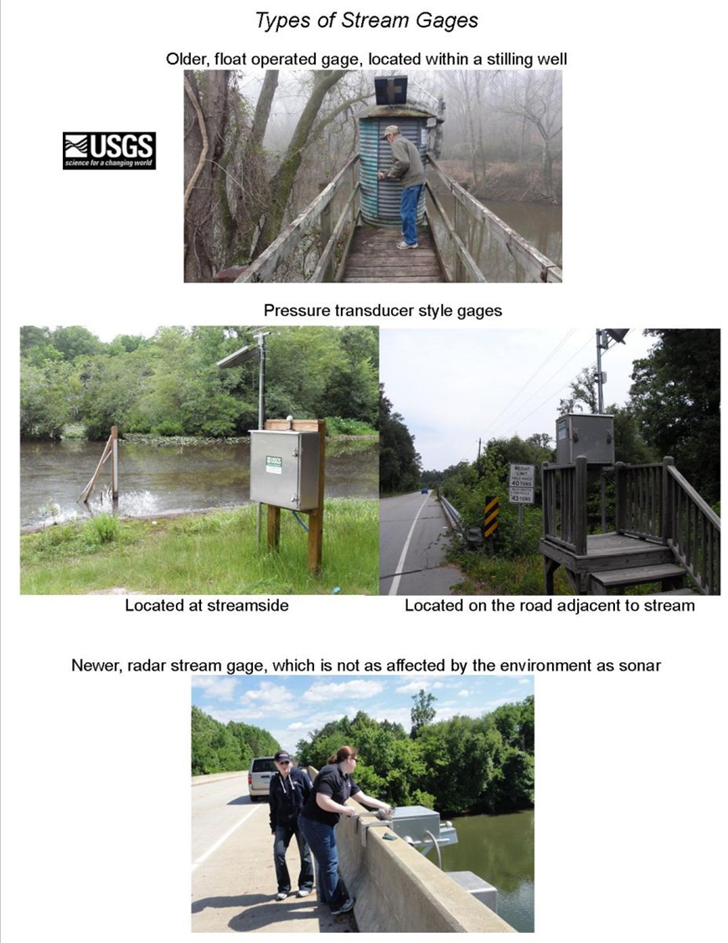
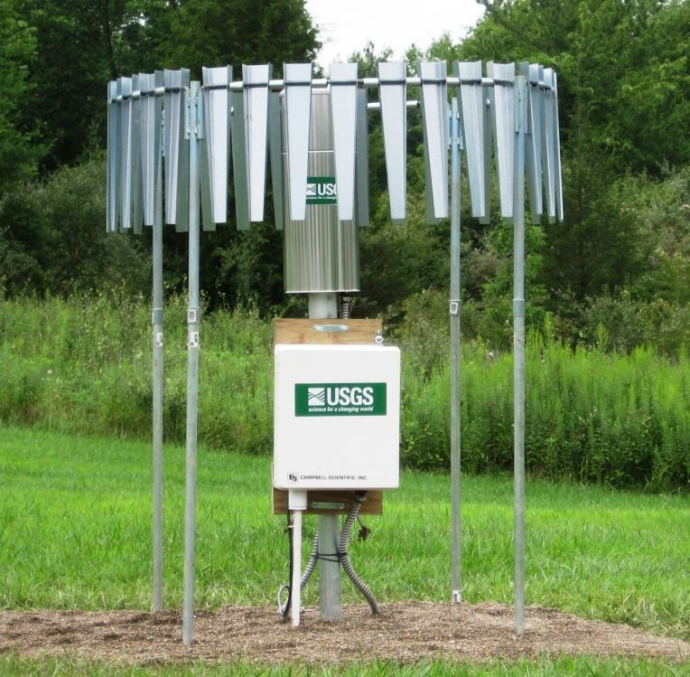
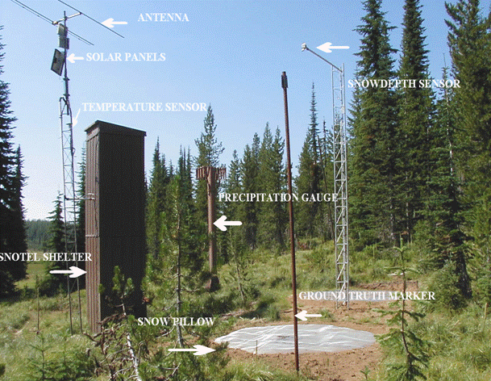

Slide 8



Slide 9
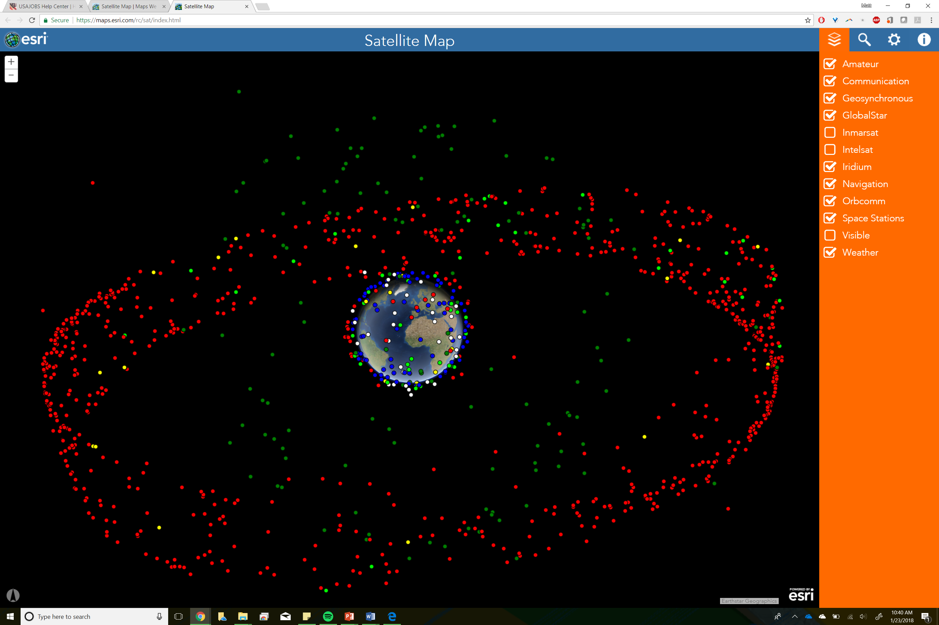
Satellite Remote Sensing

Slide 10
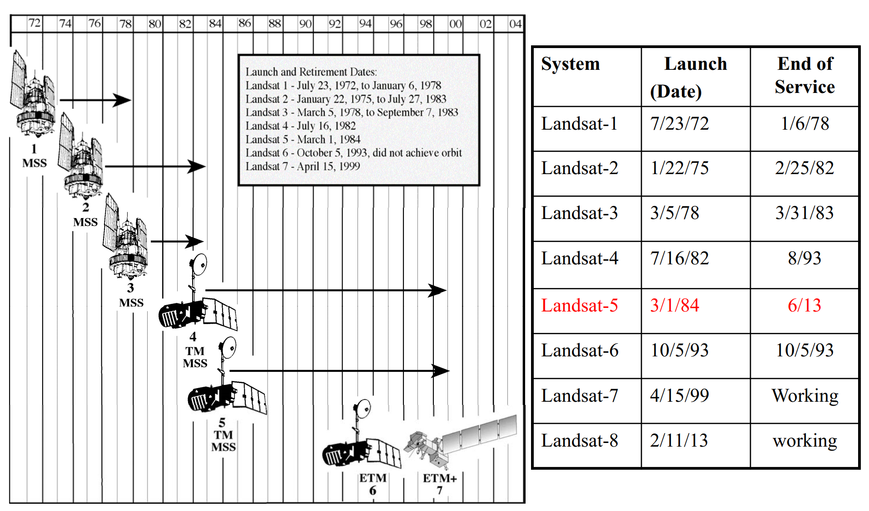
Satellite Remote Sensing

Slide 11
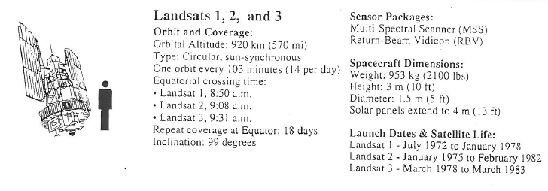
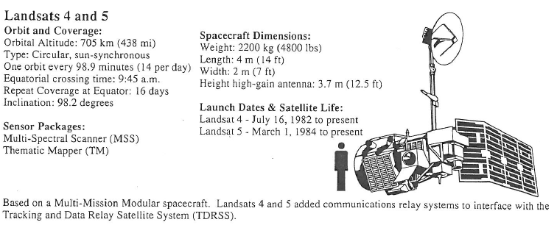

Slide 12
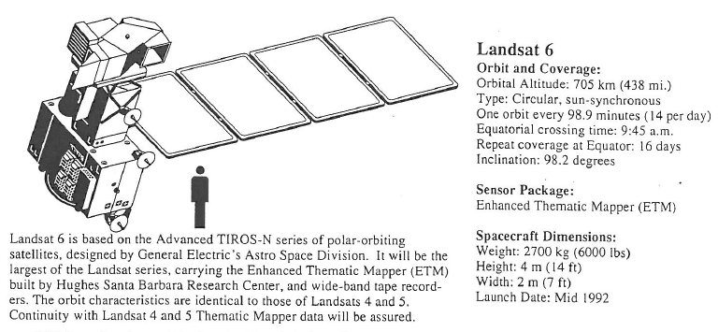
Landsat 6 (and 7)

Slide 13
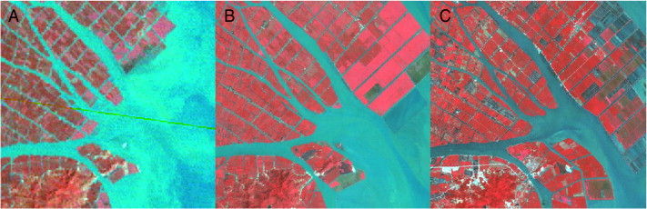
Landsat MSS-TM-ETM+ Comparison
Shanghai, China: a. MSS 1979, b. TM 1990, c. ETM+ 2000

Slide 14
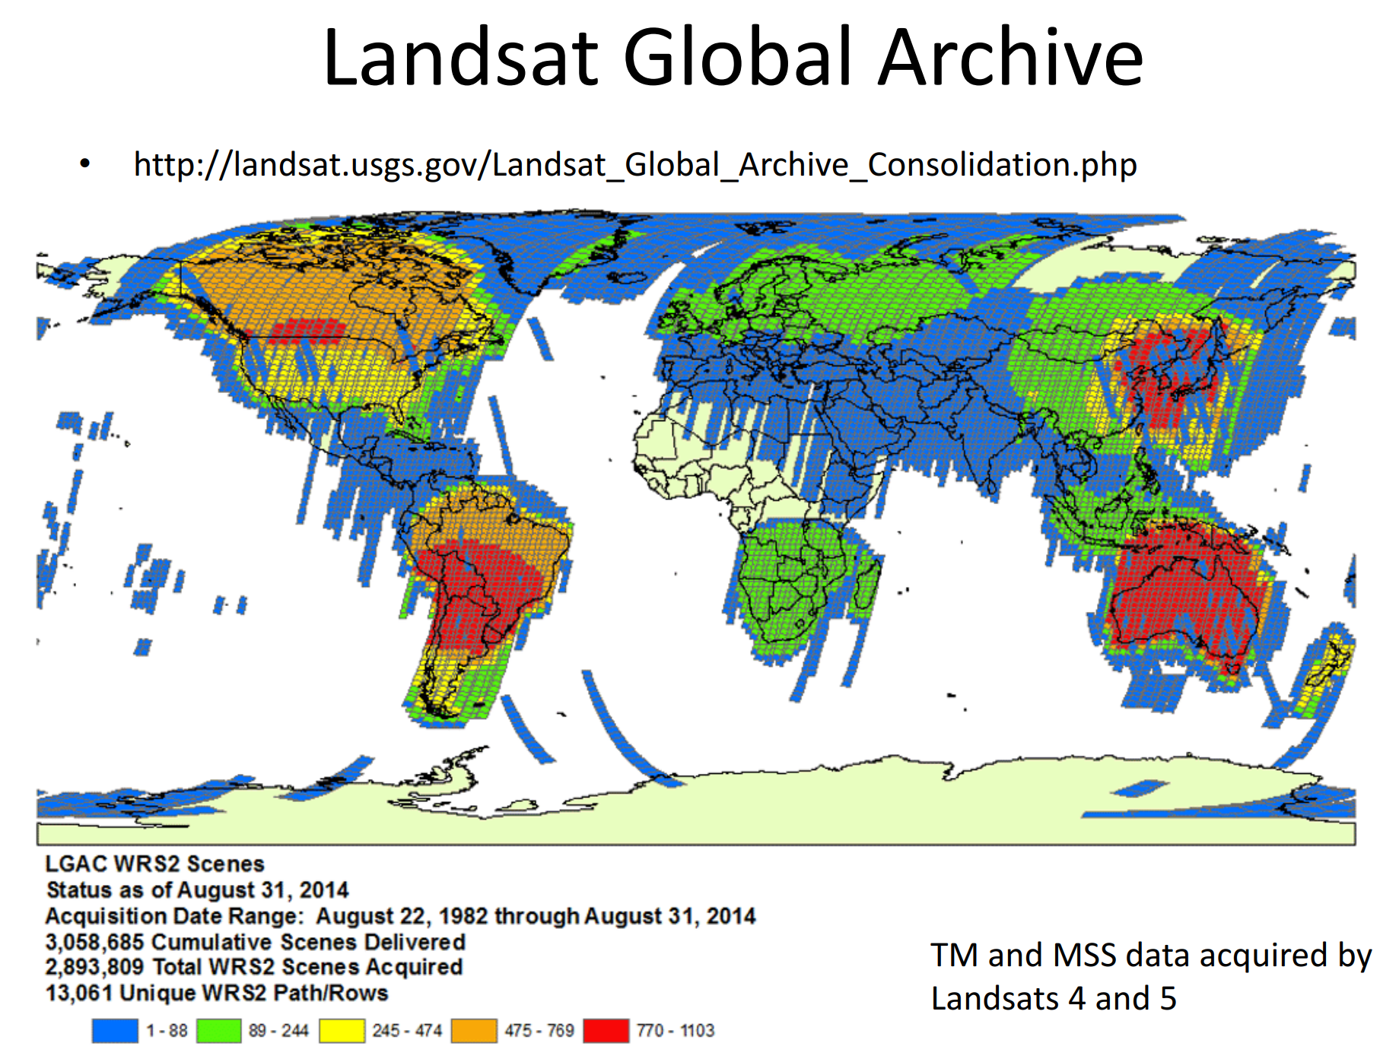

Slide 15
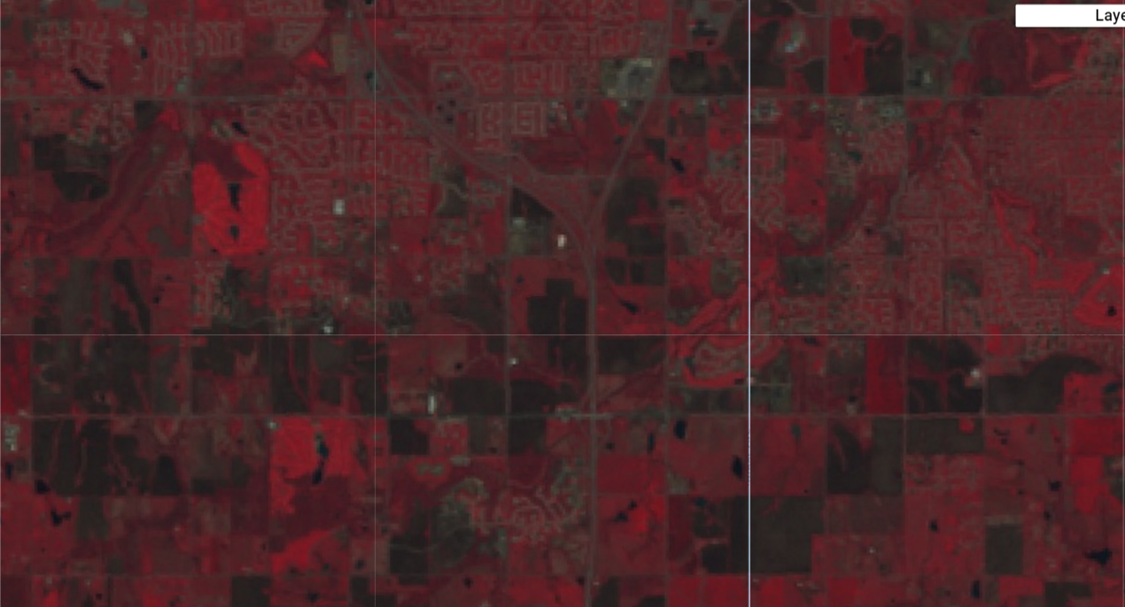
Land Cover/Use Change in Southern Overland Park (1990s)

Slide 16
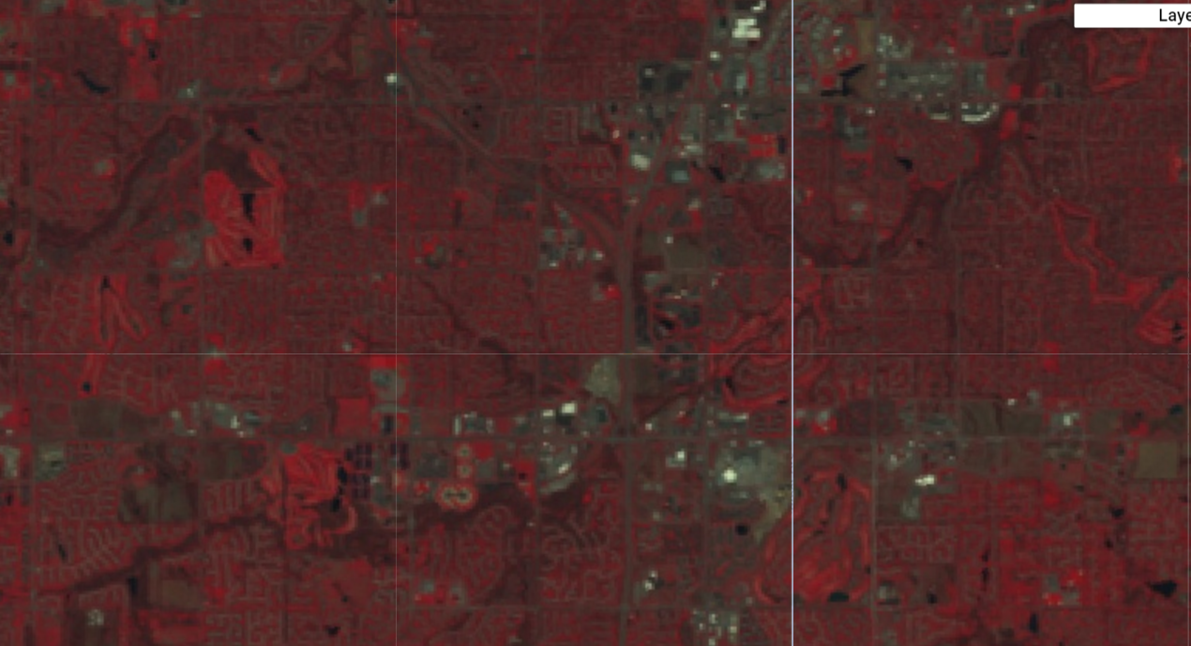
Land Cover/Use Change in Southern Overland Park (2010s)

Slide 17
Other Missions
Satellite
NASA Global Precipitation Measurement
9 satellites in 3 hours provide a global coverage
GPM overview – our wet wide world
(http://pmm.nasa.gov/education/videos/our-wet-wide-world-gpm-overview)
TRMM – Tropical Rainfall measurement mission
Overview of TRMM (http://pmm.nasa.gov/video-gallery/overview-tropical-rainfall-measuring-mission)
Airborne
NASA JPL Airborne Snow Observatory

Slide 18
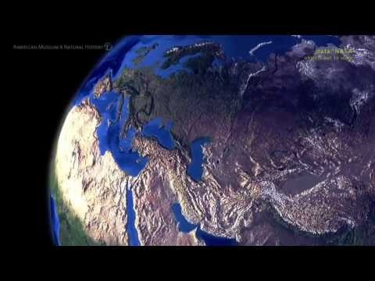
GRACE

Slide 19
What is Big Data?
Trick question: Big data is data that is too large for you to handle using your traditional methods of data processing
ArcMap
2 GB shapefiles
4 GB limit for TIFFs
Gmail: 15 GB free storage
Excel: 1,048,576 rows by 16,384 columns
LargeFile NetCDF: 8 EiB (Exbibyte, (2⁶³)) or 9,223,372 TB

Slide 20
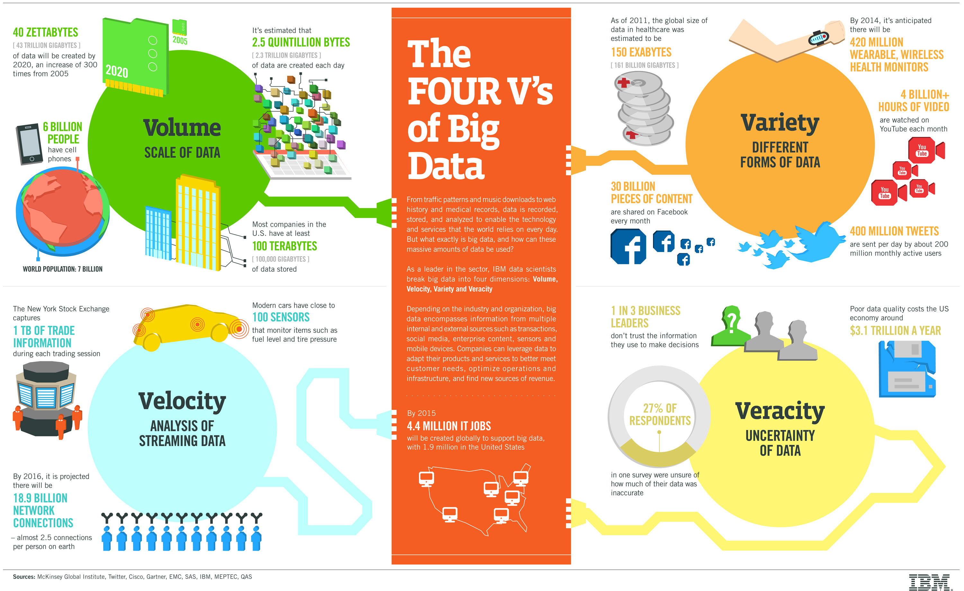
Notes:
http://www.ibmbigdatahub.com/infographic/four-vs-big-data

Slide 21
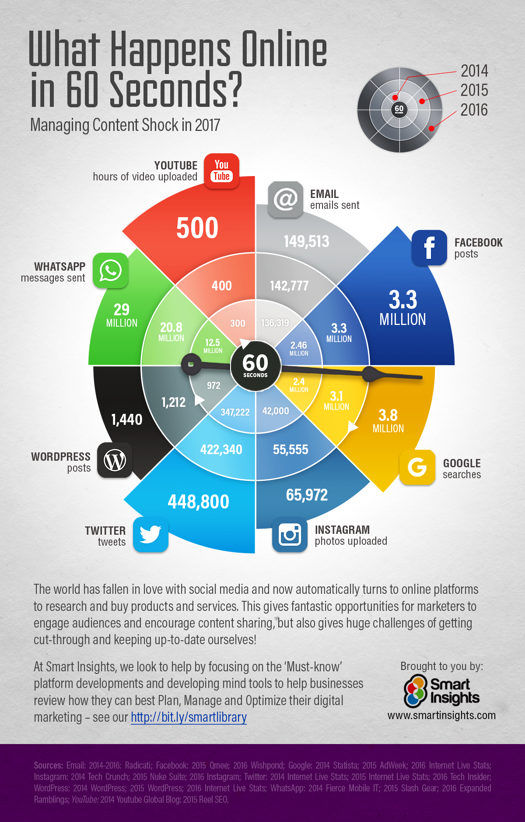
Notes:
https://www.smartinsights.com/internet-marketing-statistics/happens-online-60-seconds/

Slide 22
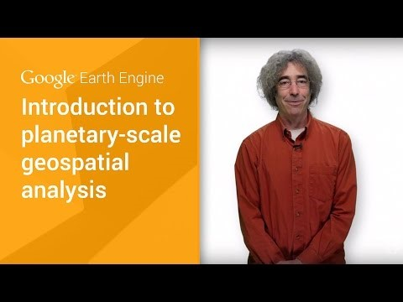
Google Earth Engine (GEE)
Notes:
USGS/NASA only provide data but not processing
Play the 3-minute introduction from GEE

Slide 23
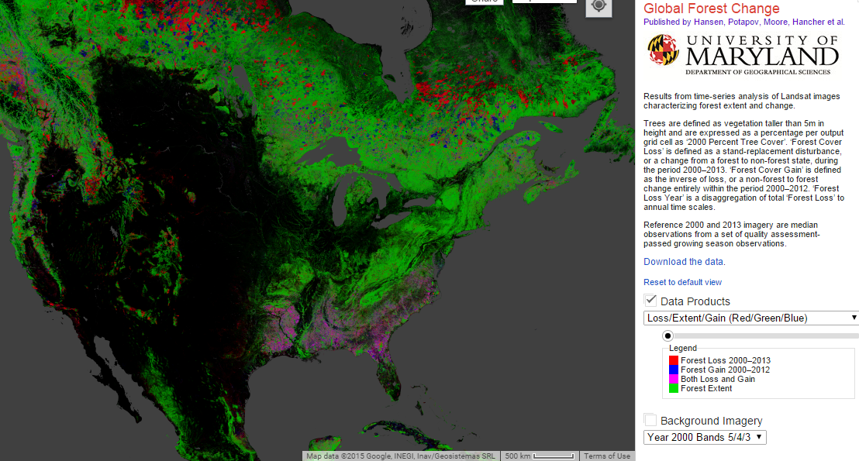
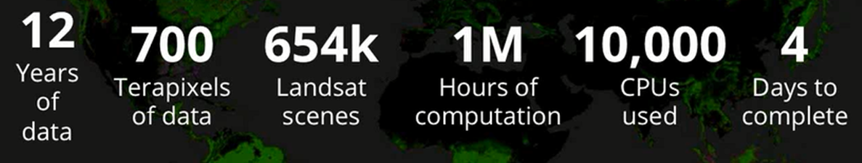
Flagship Application--Global Forest Change
Quantified global forest gain and loss from 2000-2012 at a resolution of 30 meters using Landsat data

Slide 24
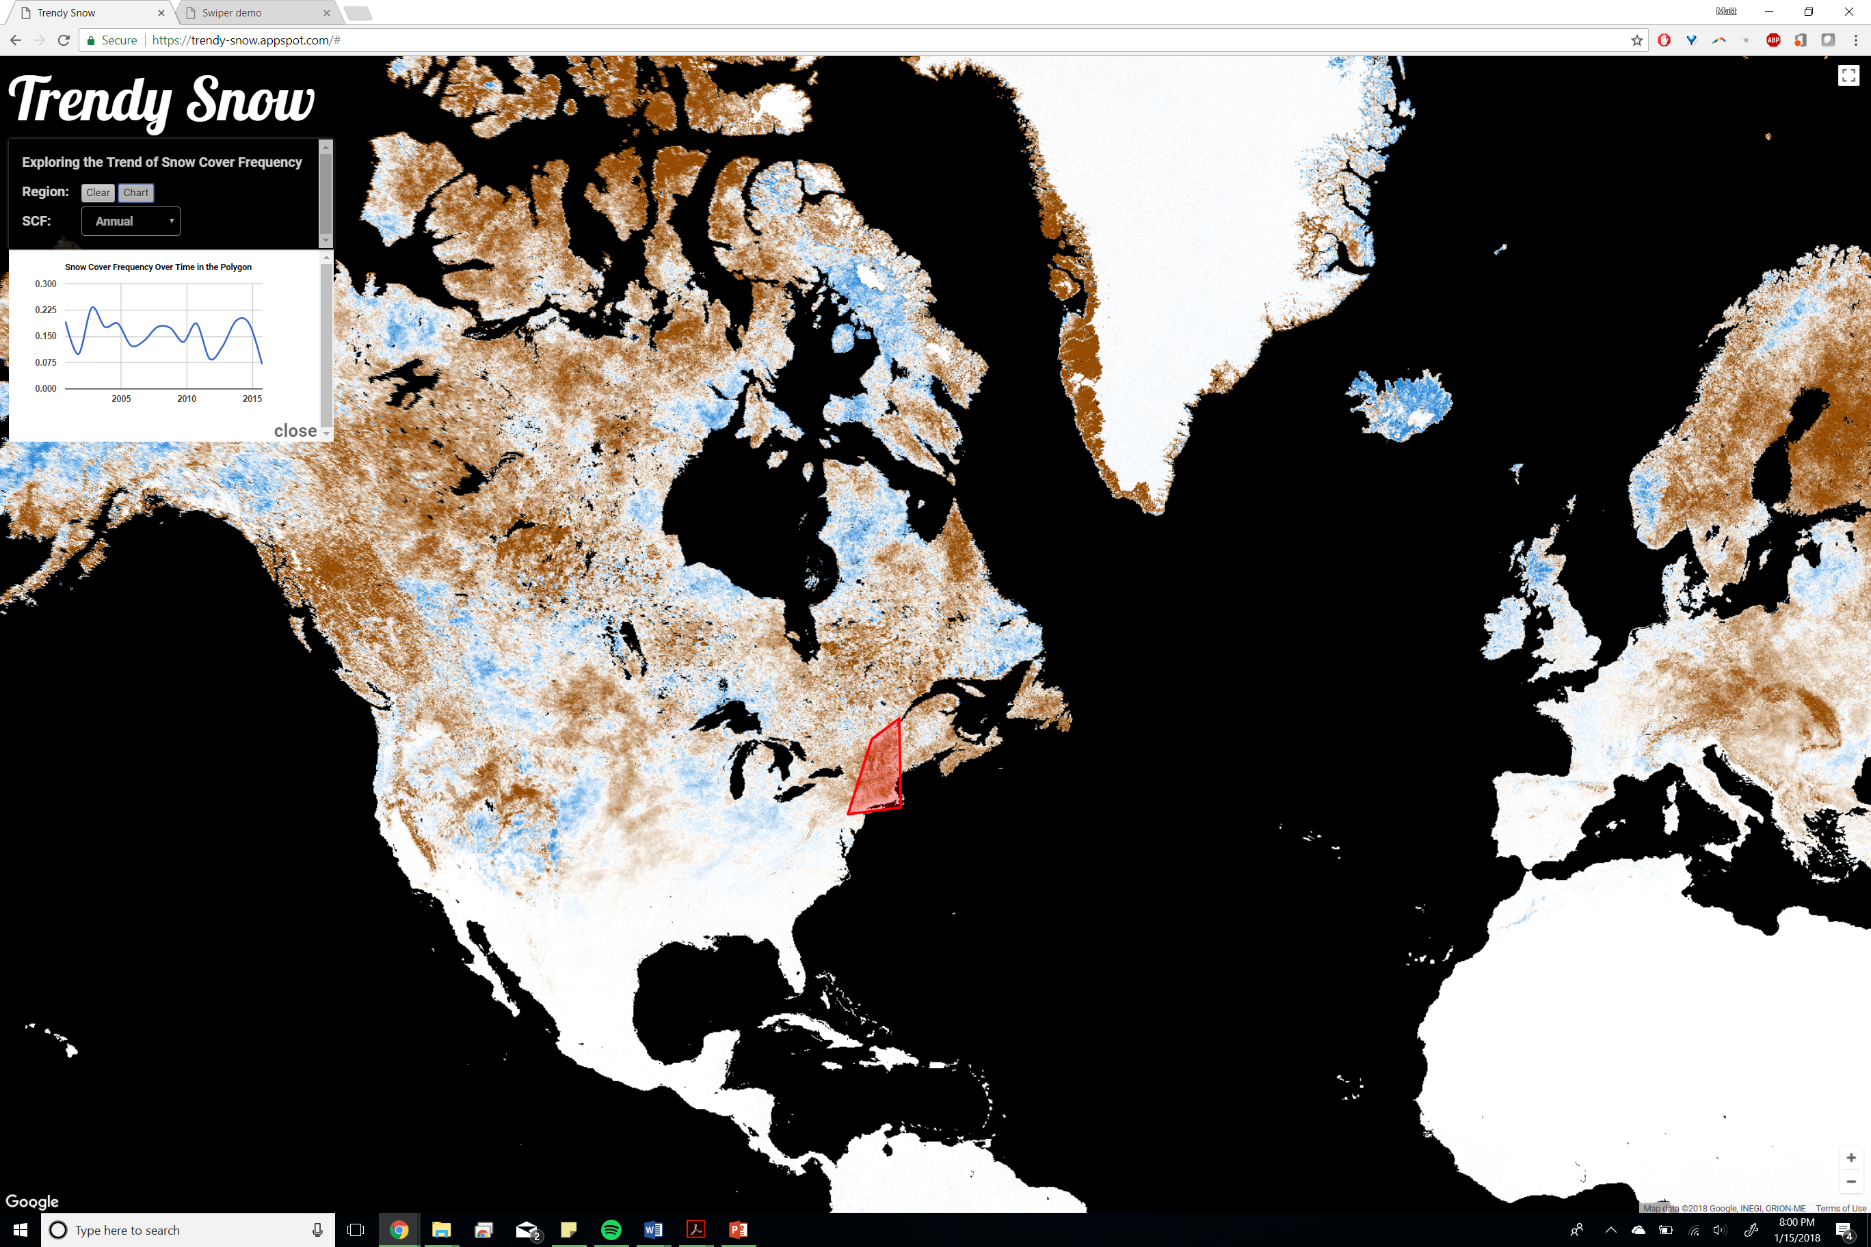

Slide 25

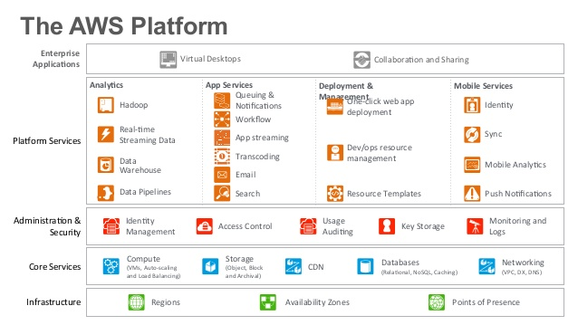

Slide 26
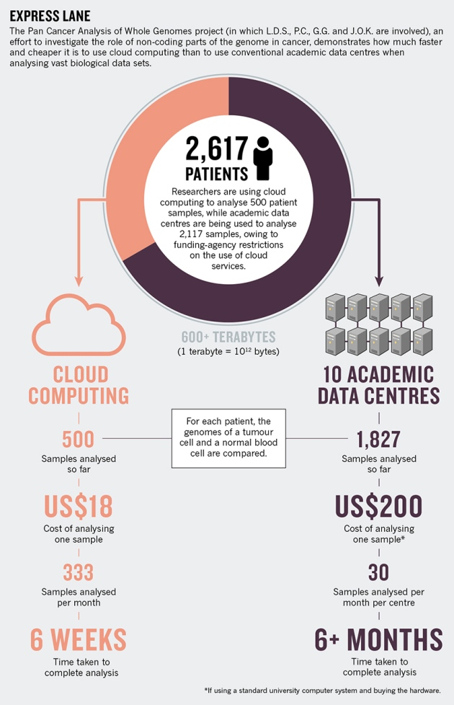
Notes:
http://www.nature.com/news/data-analysis-create-a-cloud-commons-1.17916

Slide 27
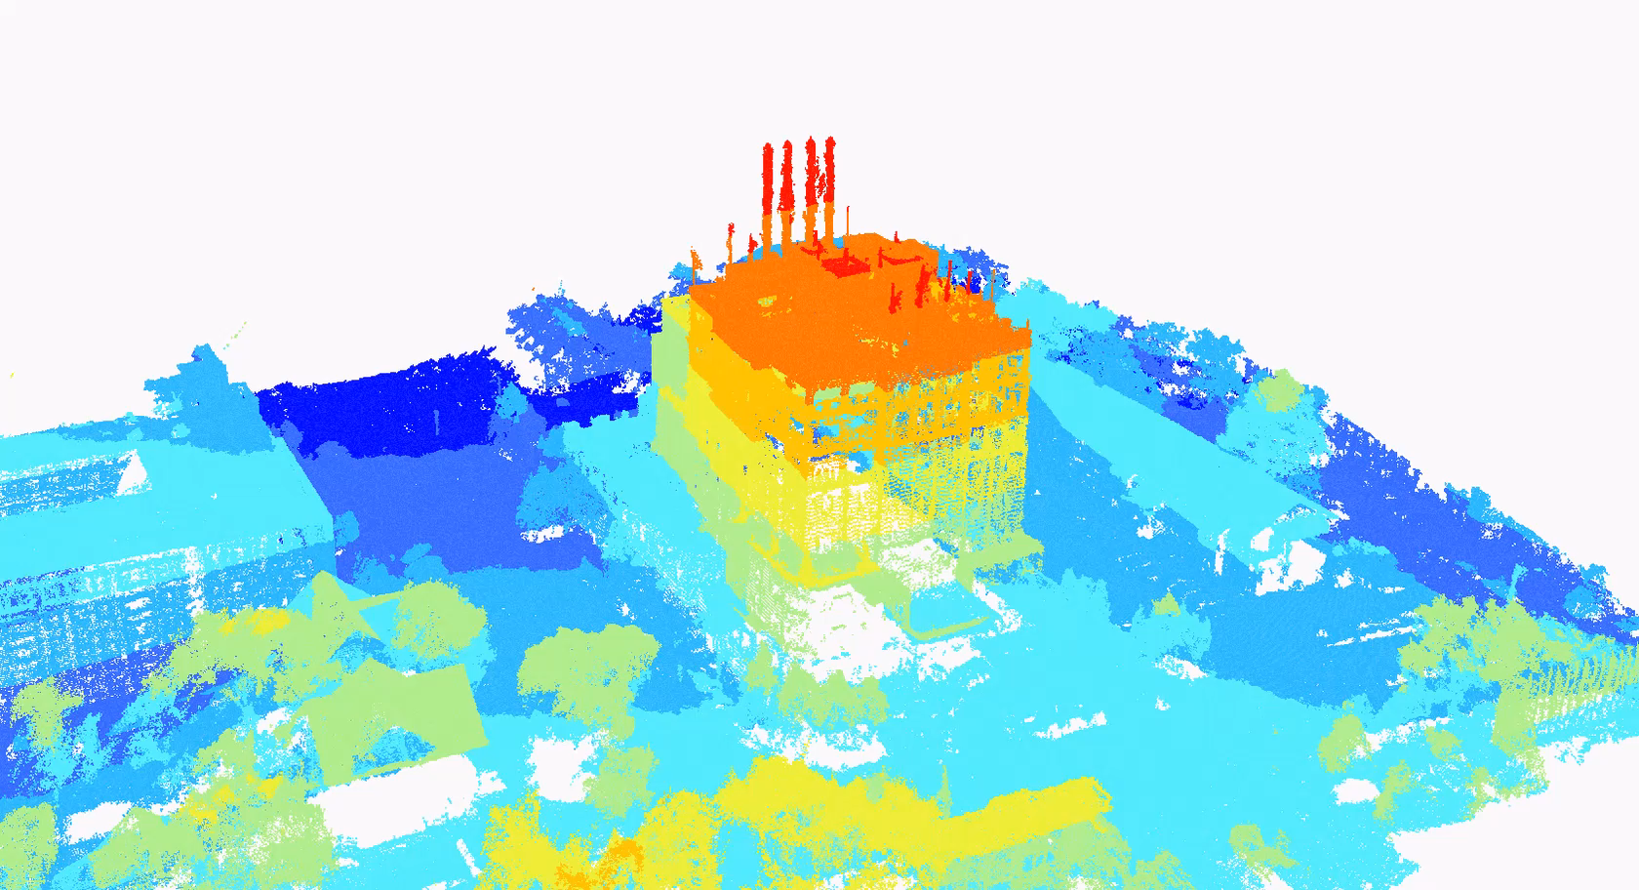


Slide 28
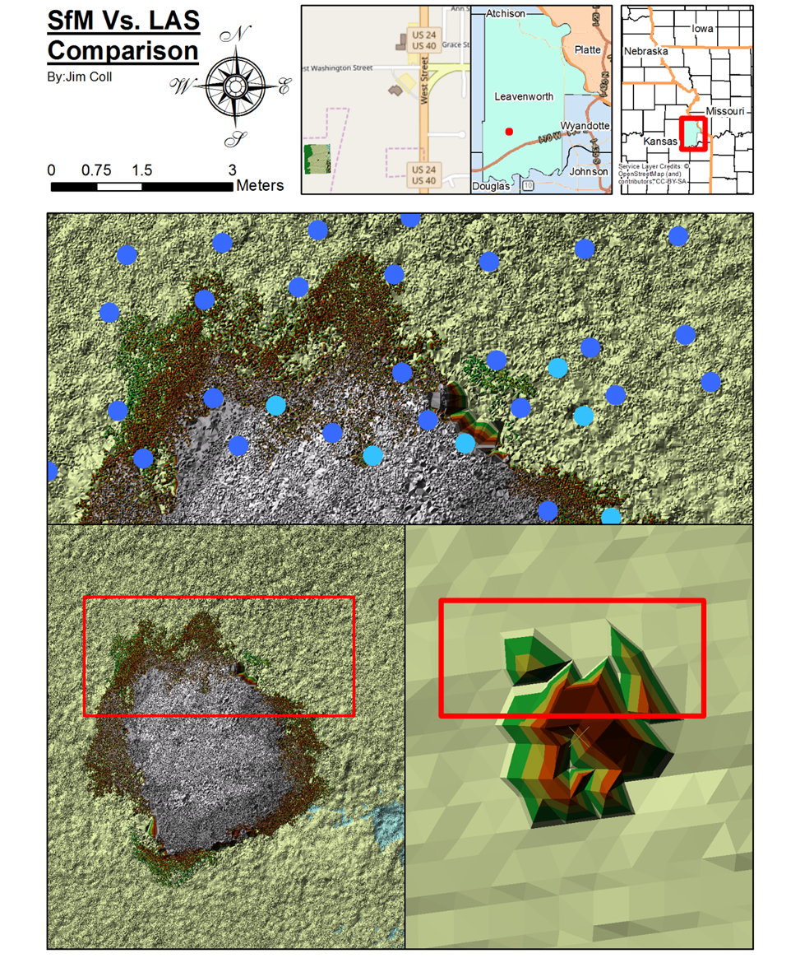

Slide 29
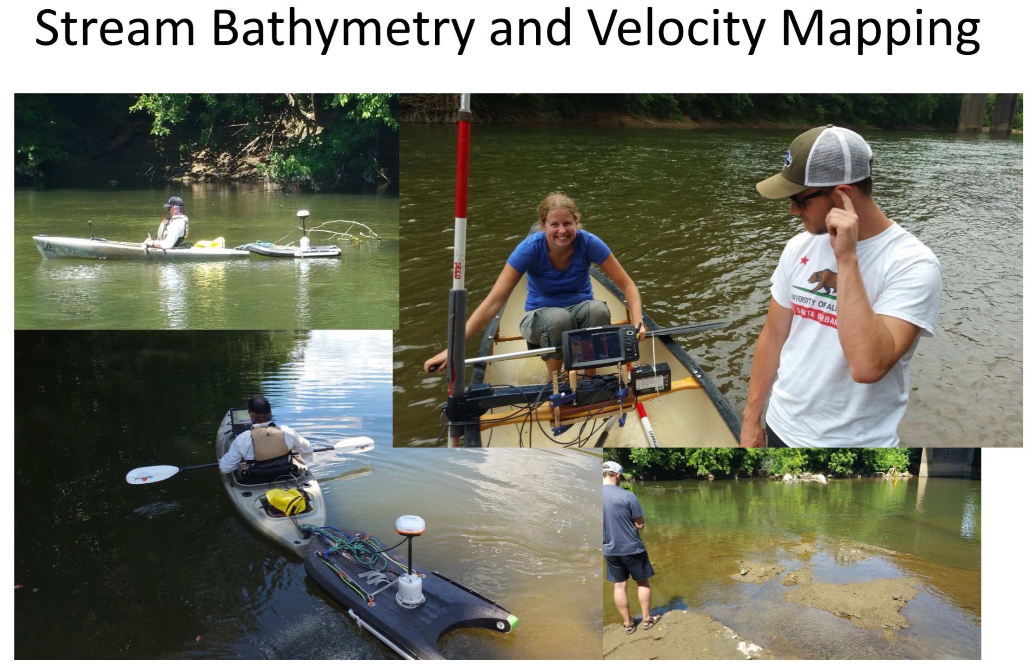

Slide 30
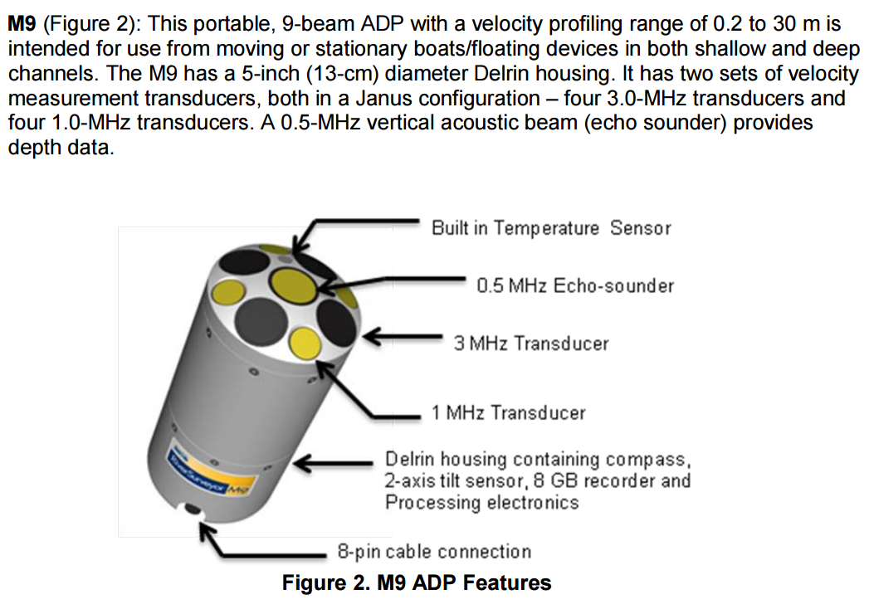
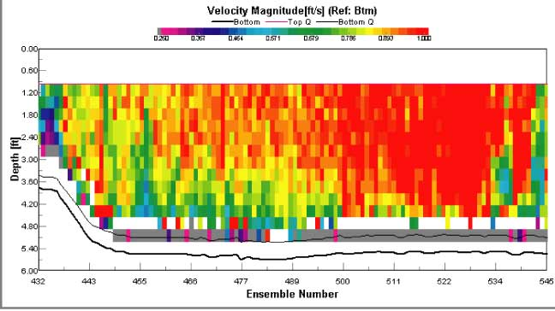
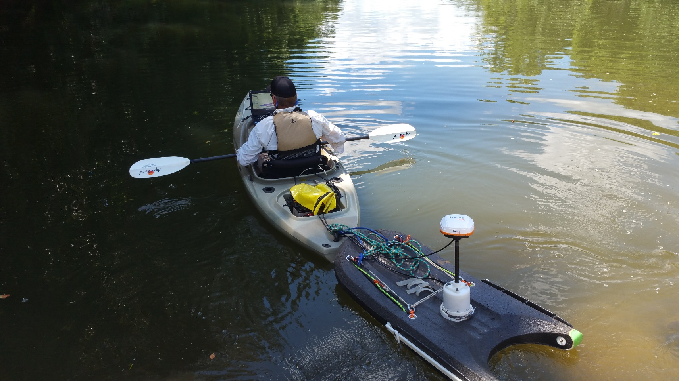
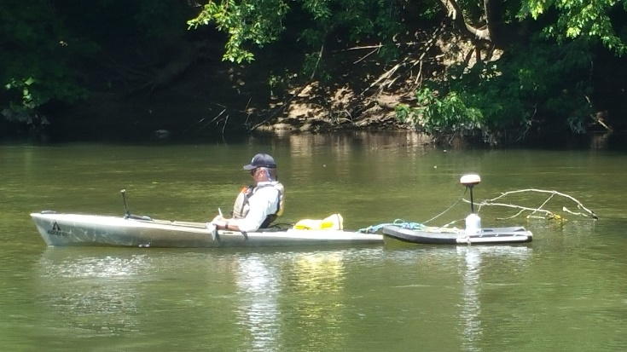

Slide 31
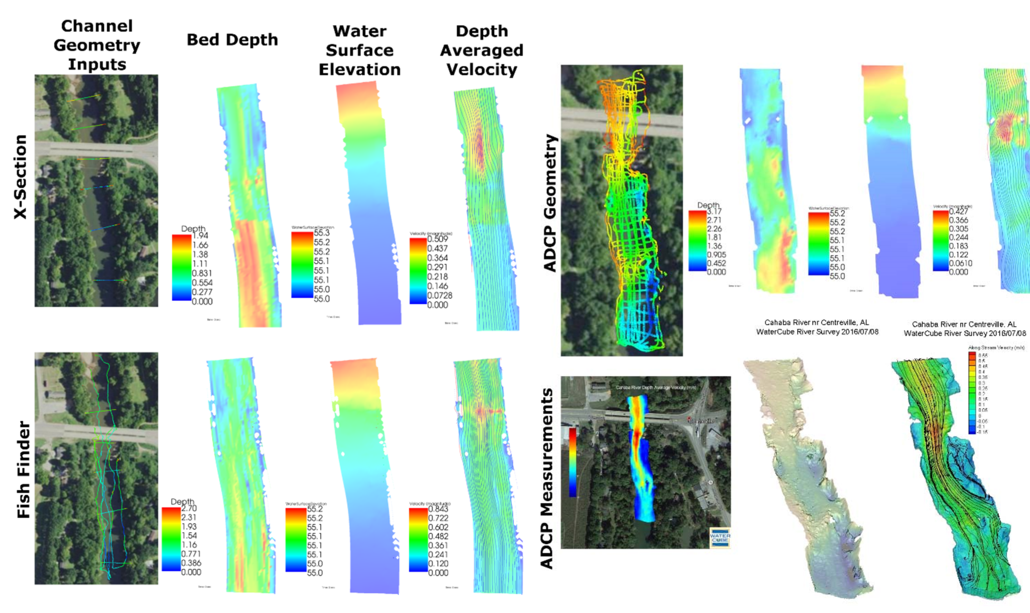

Slide 32
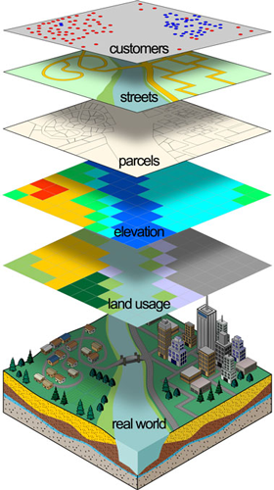
GIS Data in [insert your field here] GEOG 558 – Spring 2018

Slide 33
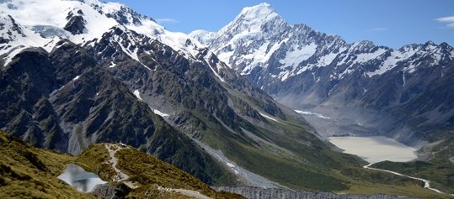
Physical Environment

Slide 34
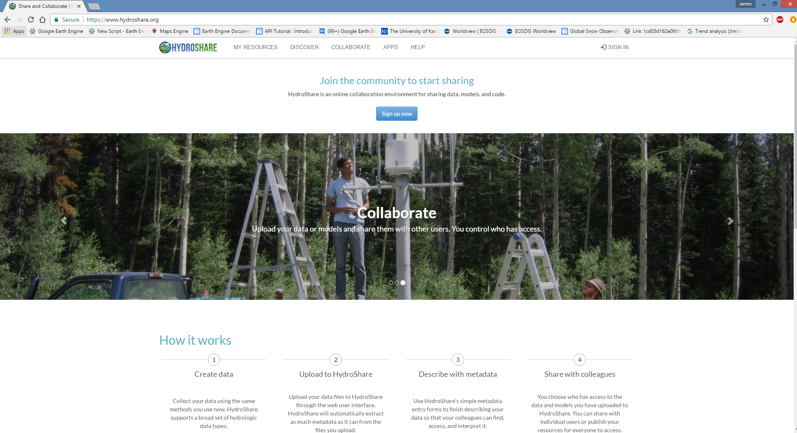

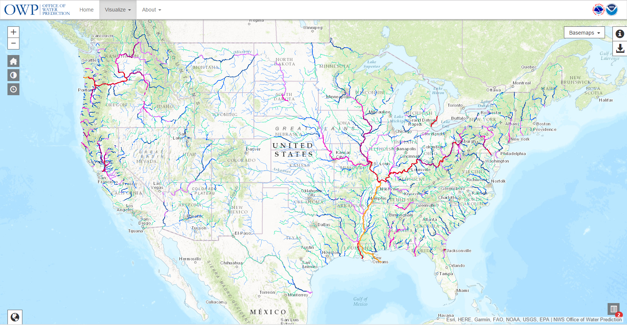

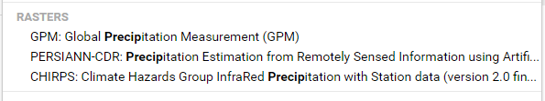
Water
Notes:
https://www.hydroshare.org/: User and canned water related datasets (Includes all USGS water and extras, some chemical/bio)
https://earthengine.google.com/: GEE (TRMM/CHIRPS/GPM/PERSIANN-CDR) (Measured and reanalysis)
http://www.prism.oregonstate.edu/: PRISM precip data (reanalysis)
http://www.horizon-systems.com/nhdplus/: NHDPlus, hydro oriented land cover and stream networks
http://water.noaa.gov/map: National water model outputs

Slide 35
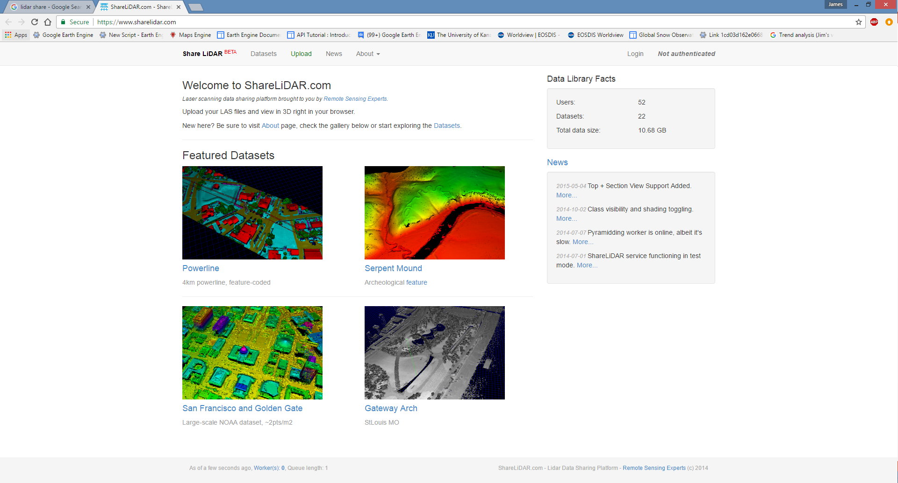

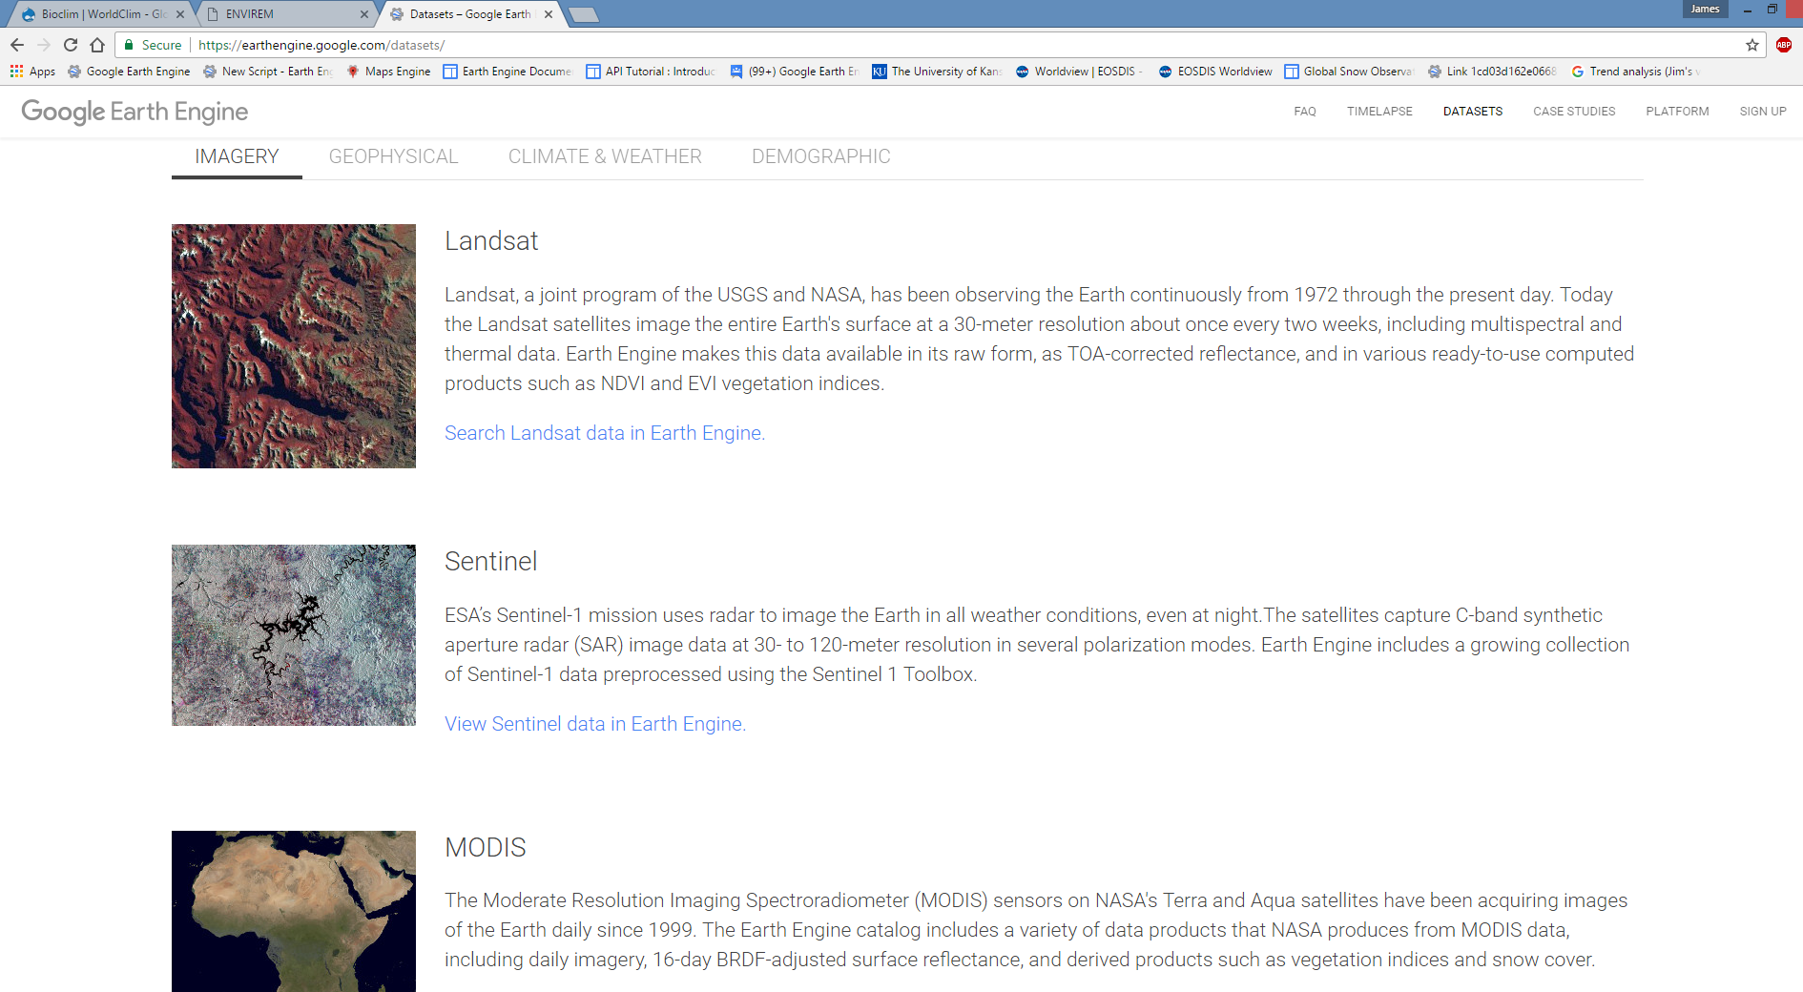
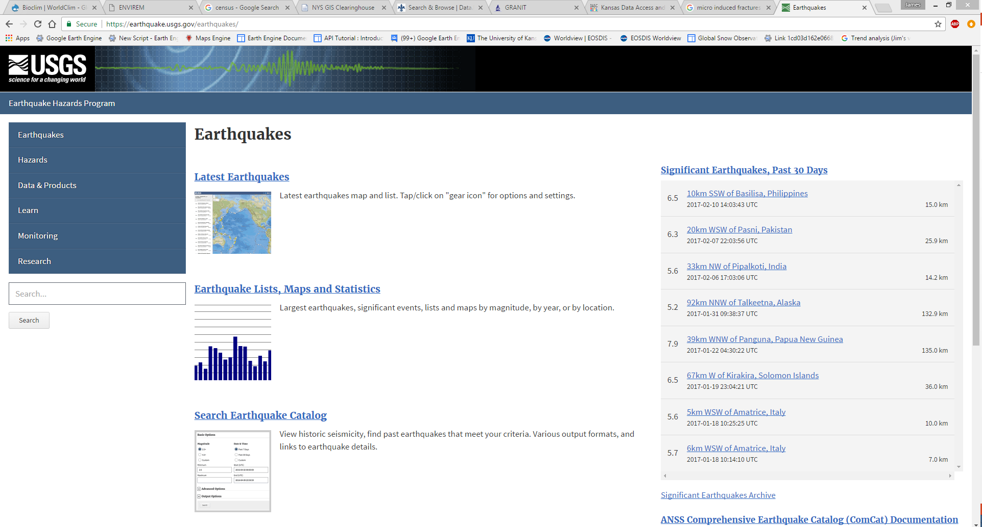
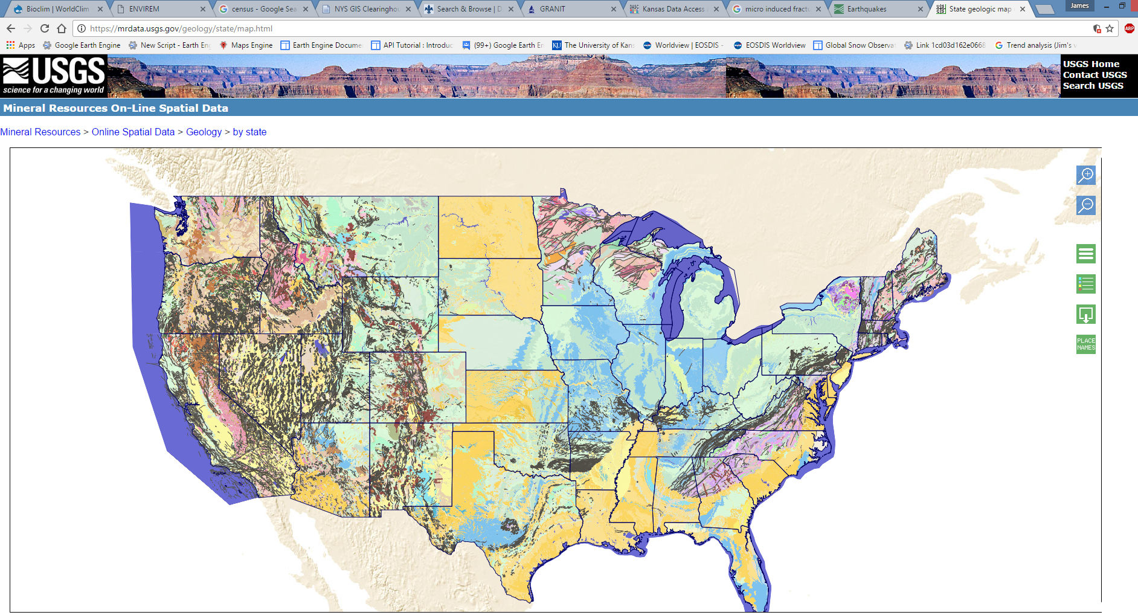
Land
Notes:
https://earthquake.usgs.gov/earthquakes/map/: Earthquakes
https://earthengine.google.com/: GEE (Landsat/MODIS/Sentianl/Extras)
https://www.sharelidar.com/: User generated LiDAR, structure/application specific
http://www.opentopography.org/: OpenTopo, High res data and tools, also a smaller collection

Slide 36
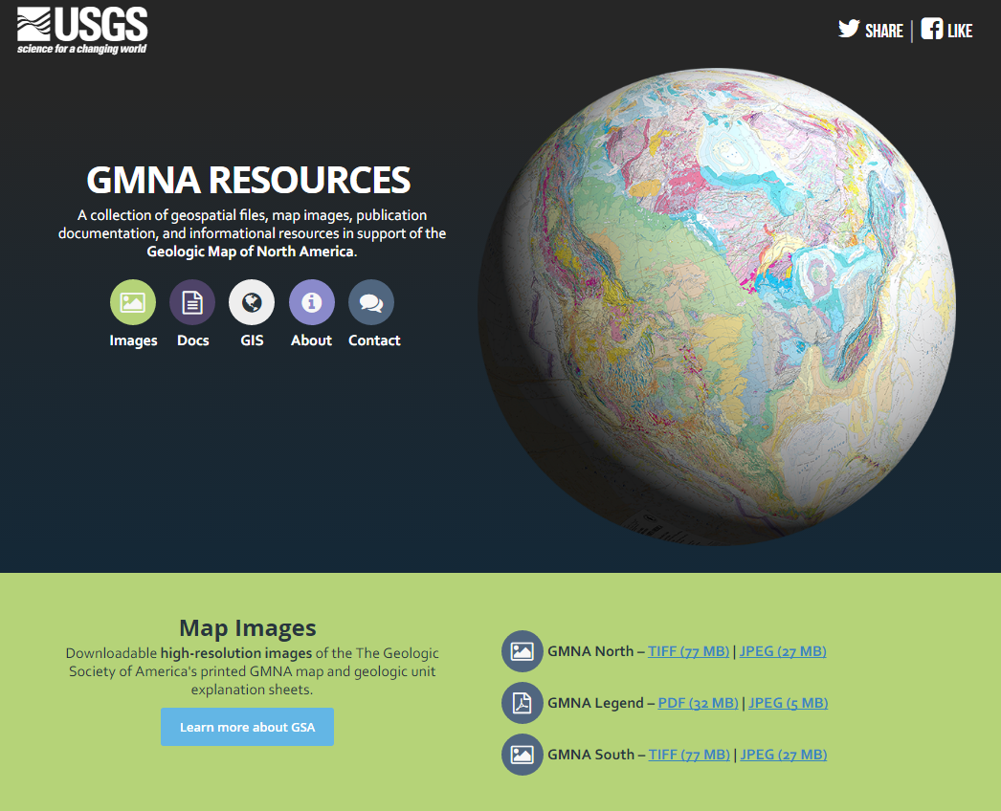
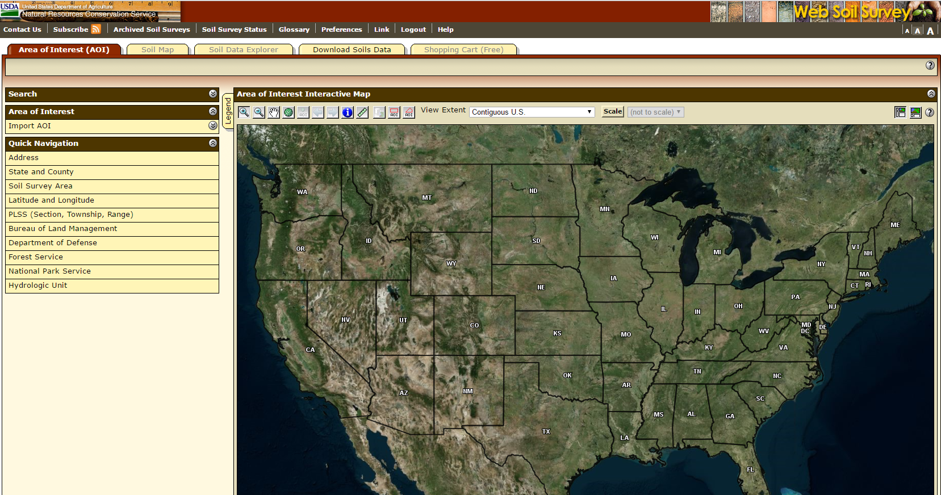
Notes:
https://ngmdb.usgs.gov/gmna/#gmnaGeo: Soils and more
https://websoilsurvey.sc.egov.usda.gov/App/WebSoilSurvey.aspx: Soils information, particularly hydraulic properties

Slide 37
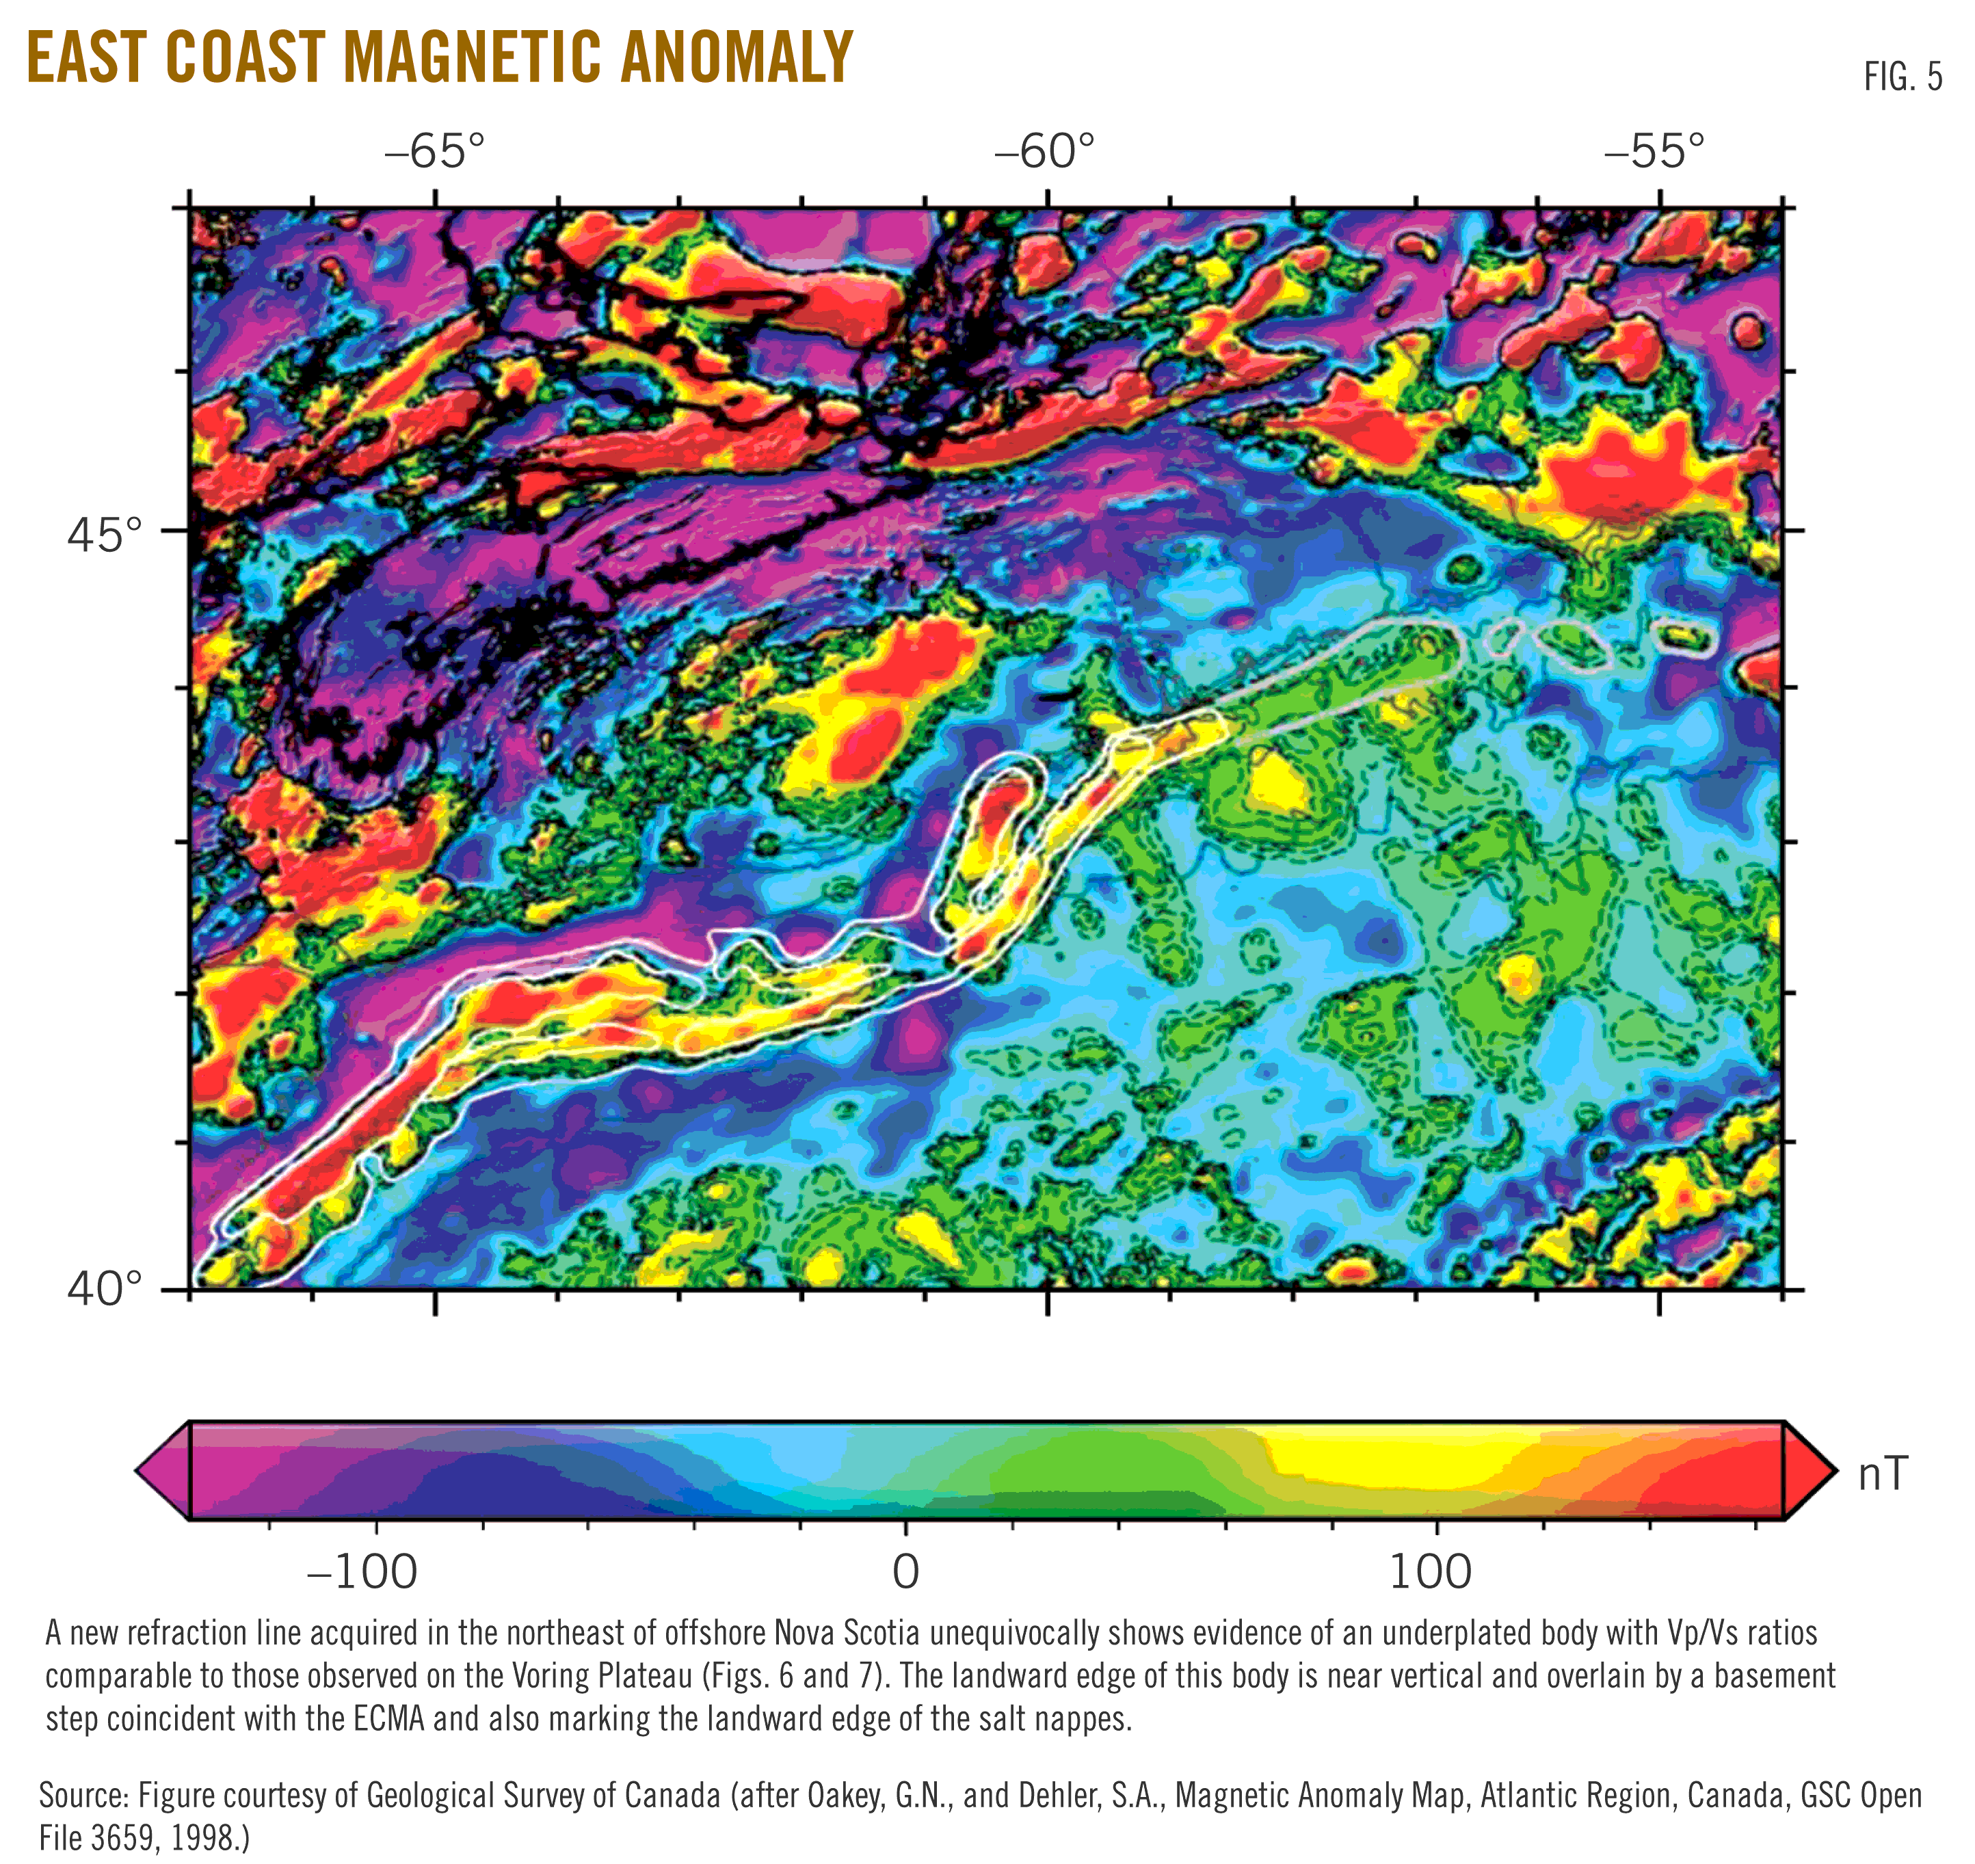
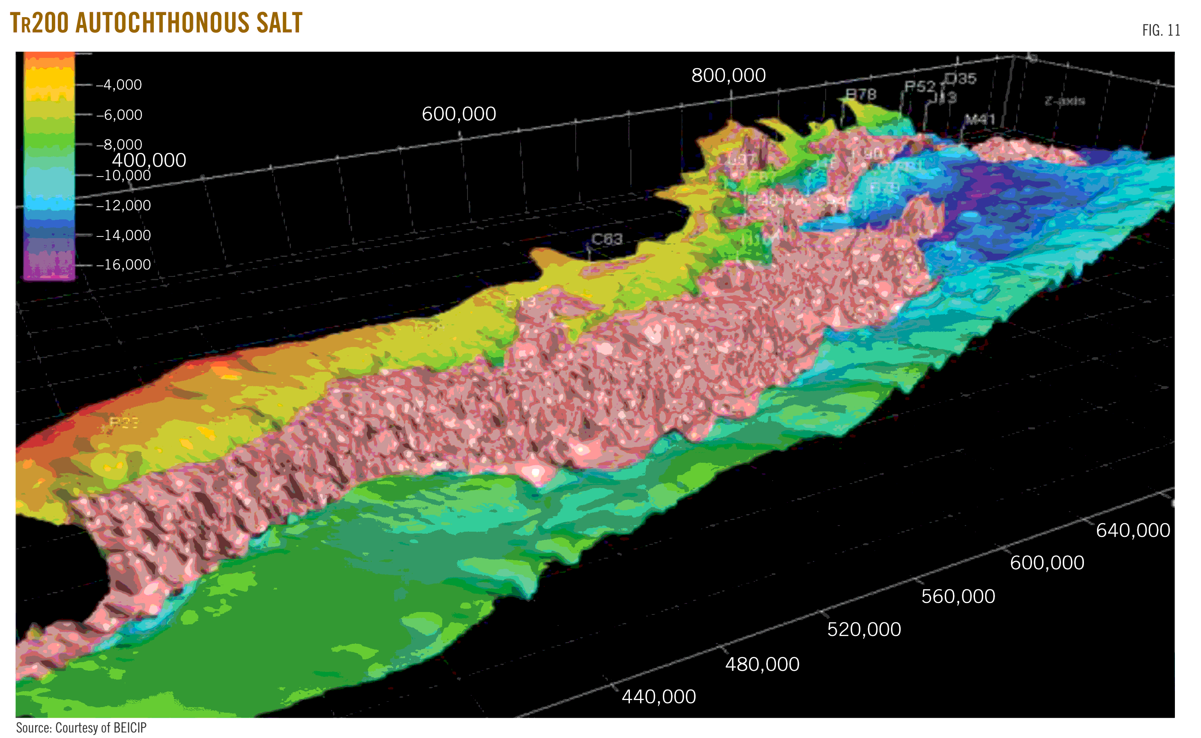
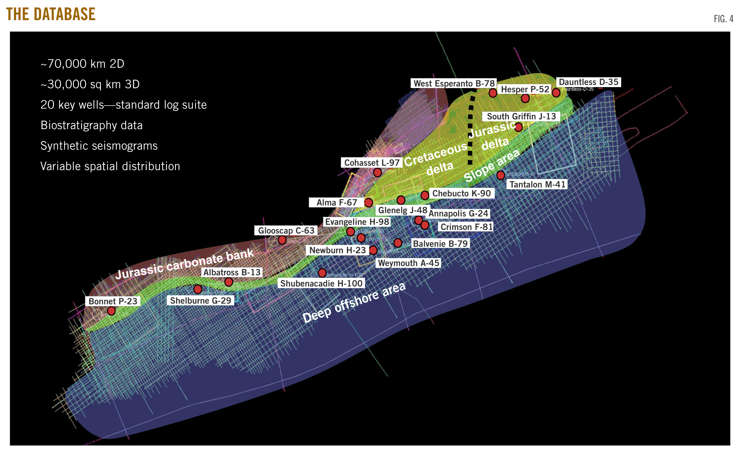
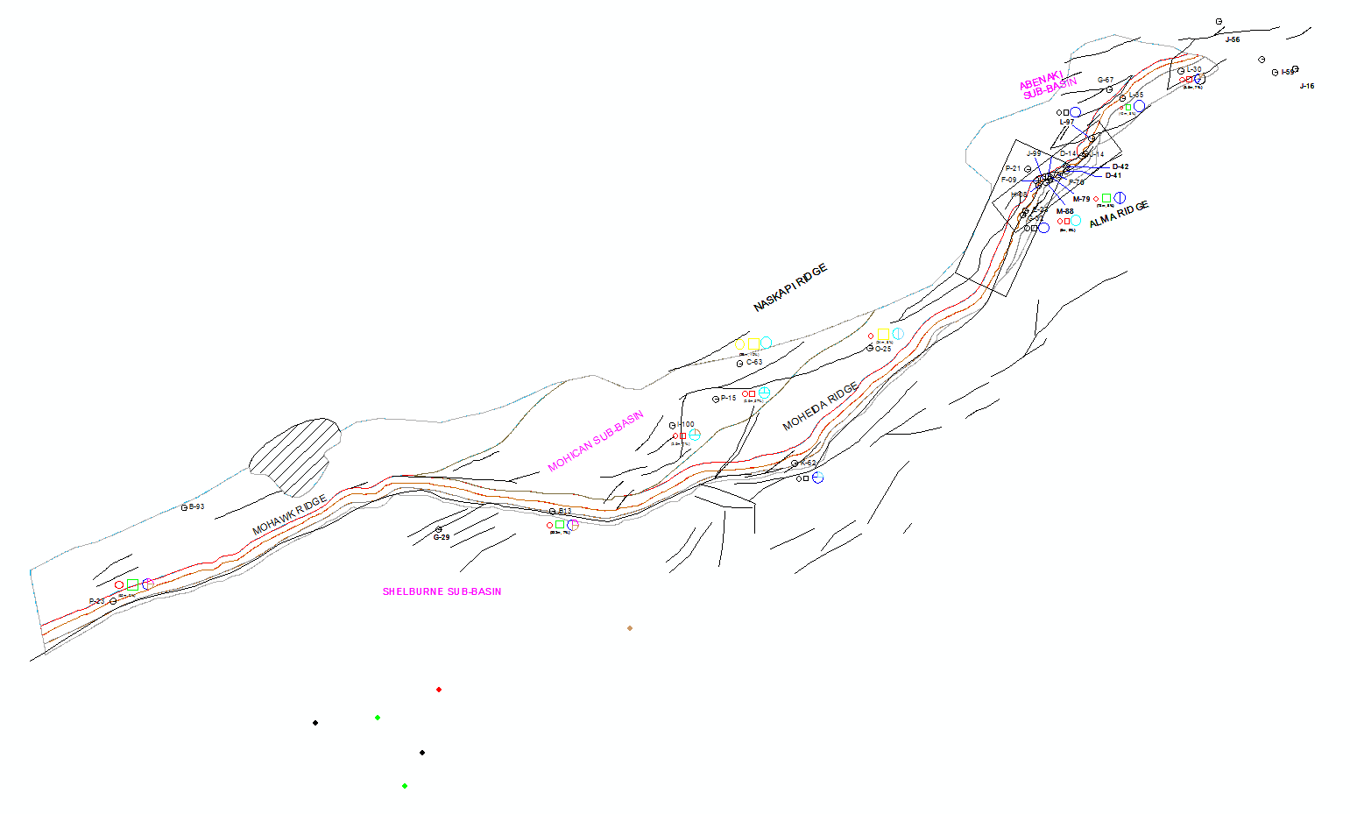
Notes:
Location specific surveys: http://energy.novascotia.ca/oil-and-gas/offshore/play-fairway-analysis

Slide 38
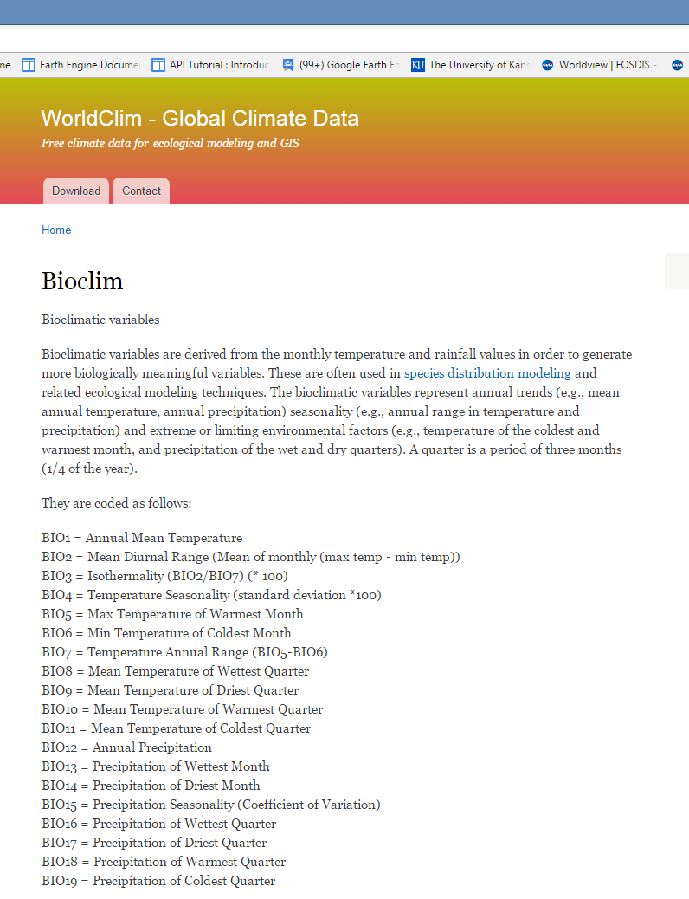
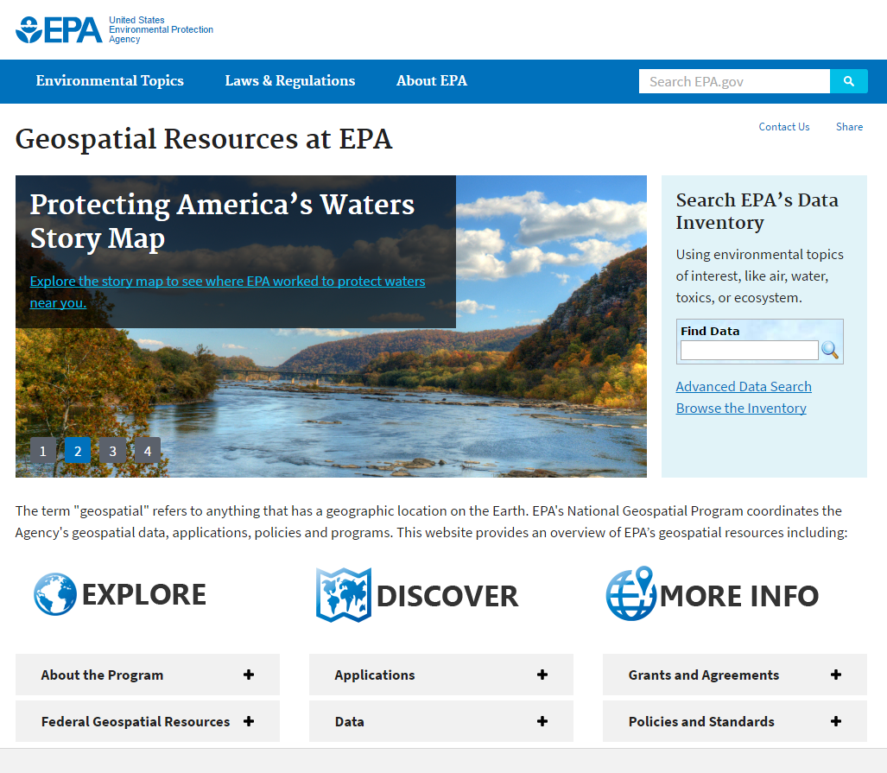
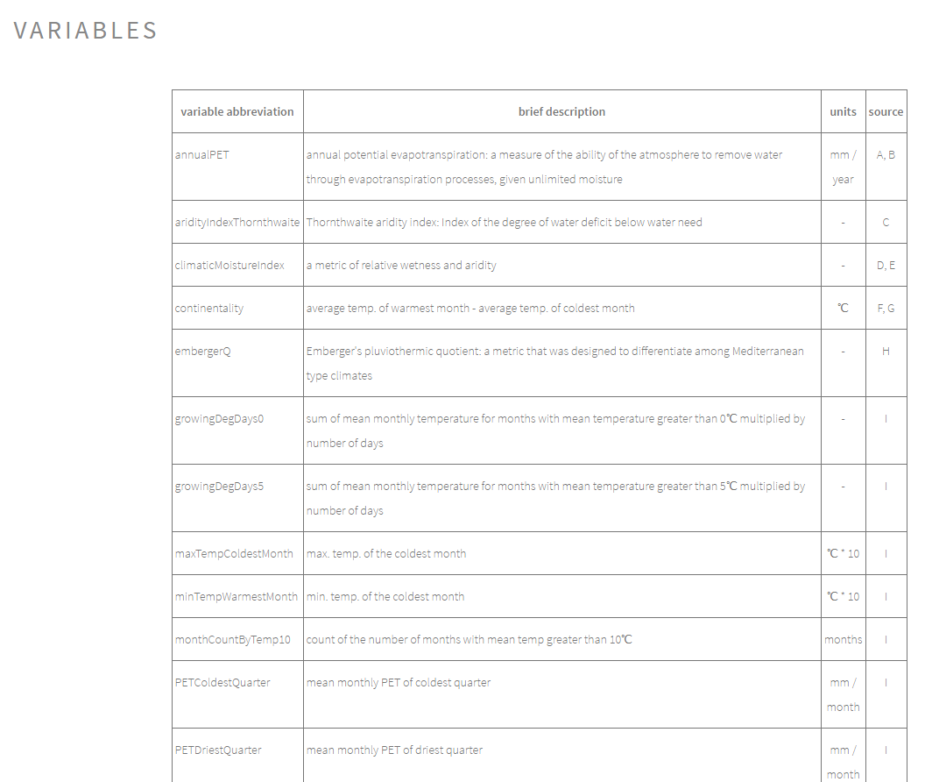

Air
Notes:
http://www.worldclim.org/bioclim: Bio norms
http://envirem.github.io/: More Bio Norms
https://earthengine.google.com/: GEE (MODIS/Sentinal)
https://www.epa.gov/geospatial: Includes land and water, but also includes a large selection of air quality data

Slide 39




Human
Notes:
ESRI: Large accumulation of political boundaries
GEE: Worldpop
https://www.census.gov/: Census data
https://www.openstreetmap.org/#map=5/51.500/-0.100

Slide 40






Notes:
Found by searching GIS and [State Name]

Slide 41






GIS-enabled applications
Notes:
http://www.naturalcapitalproject.org/:
https://www.epa.gov/exposure-assessment-models/basins-case-study
http://www.hec.usace.army.mil/software/hec-ras/
http://www.esri.com/software/cityengine
https://www.software.slb.com/products/petrel/petrel-geology-and-modeling

Slide 42

Sources
GIS!
Images:
http://geography.name/physical-geography/
http://www.williamsnd.com/Department/GIS
https://sites.google.com/a/splendoraisd.org/coach-reneau-ap-human-geography/
https://investingcaffeine.com/tag/mini-me/
https://mic.com/articles/127814/captain-planet-tv-show-plot
http://www.evermotion.org/tutorials/show/7971/cityengine-review
https://unfccc.int/files/national_reports/non-annex_i_natcom/application/pdf/ch_6_water_resources_rev1.pdf
https://freegisdata.rtwilson.com/

Slide 43
Thursday: Guest Lecture
Kristen Jordan‐Koenig, DASC/KGS

Slide 44
Readings for next week
Chapters 3&4 of the book
http://www.spatialanalysisonline.com/HTML/index.html

